Slide 1
Mid-Presentation: An Algorithm to Improve Image Matching for a Piecewise Planar World
Bo Cao (KIT)
Supervisor: M.Sc. Bastian Erdnüß (IOSB) and Prof. Dr. Ralf Mikut (IAI)
Notes:
Good afternoon ladies and gentlemen. I am Bo Cao a mechanical engineering student at KIT. I am so glad, that you could be here to listen to my mid-presentation. Right now I am doing my master Thesis [‘θi:sis] under the supervision of Mr. Erdnuess and Prof. Dr. Mikut. The working title ['taitl]of my master thesis is an algorithm to improve image matching for a piecewise planar world. It‘s an algorithm using multiple homography to register image patches. Let’s get started.

Slide 2
Agenda
Introduction
Approach
Evaluation
Future Improvement
Notes:
My presentation is divided into 4 sections. At the beginning , I would introduce the current status of research in the related fields and why this algorithm is needed. Then I will talk about the main body of the thesis. Finally, I will share with you the Evaluation so far and Future work.

Slide 3
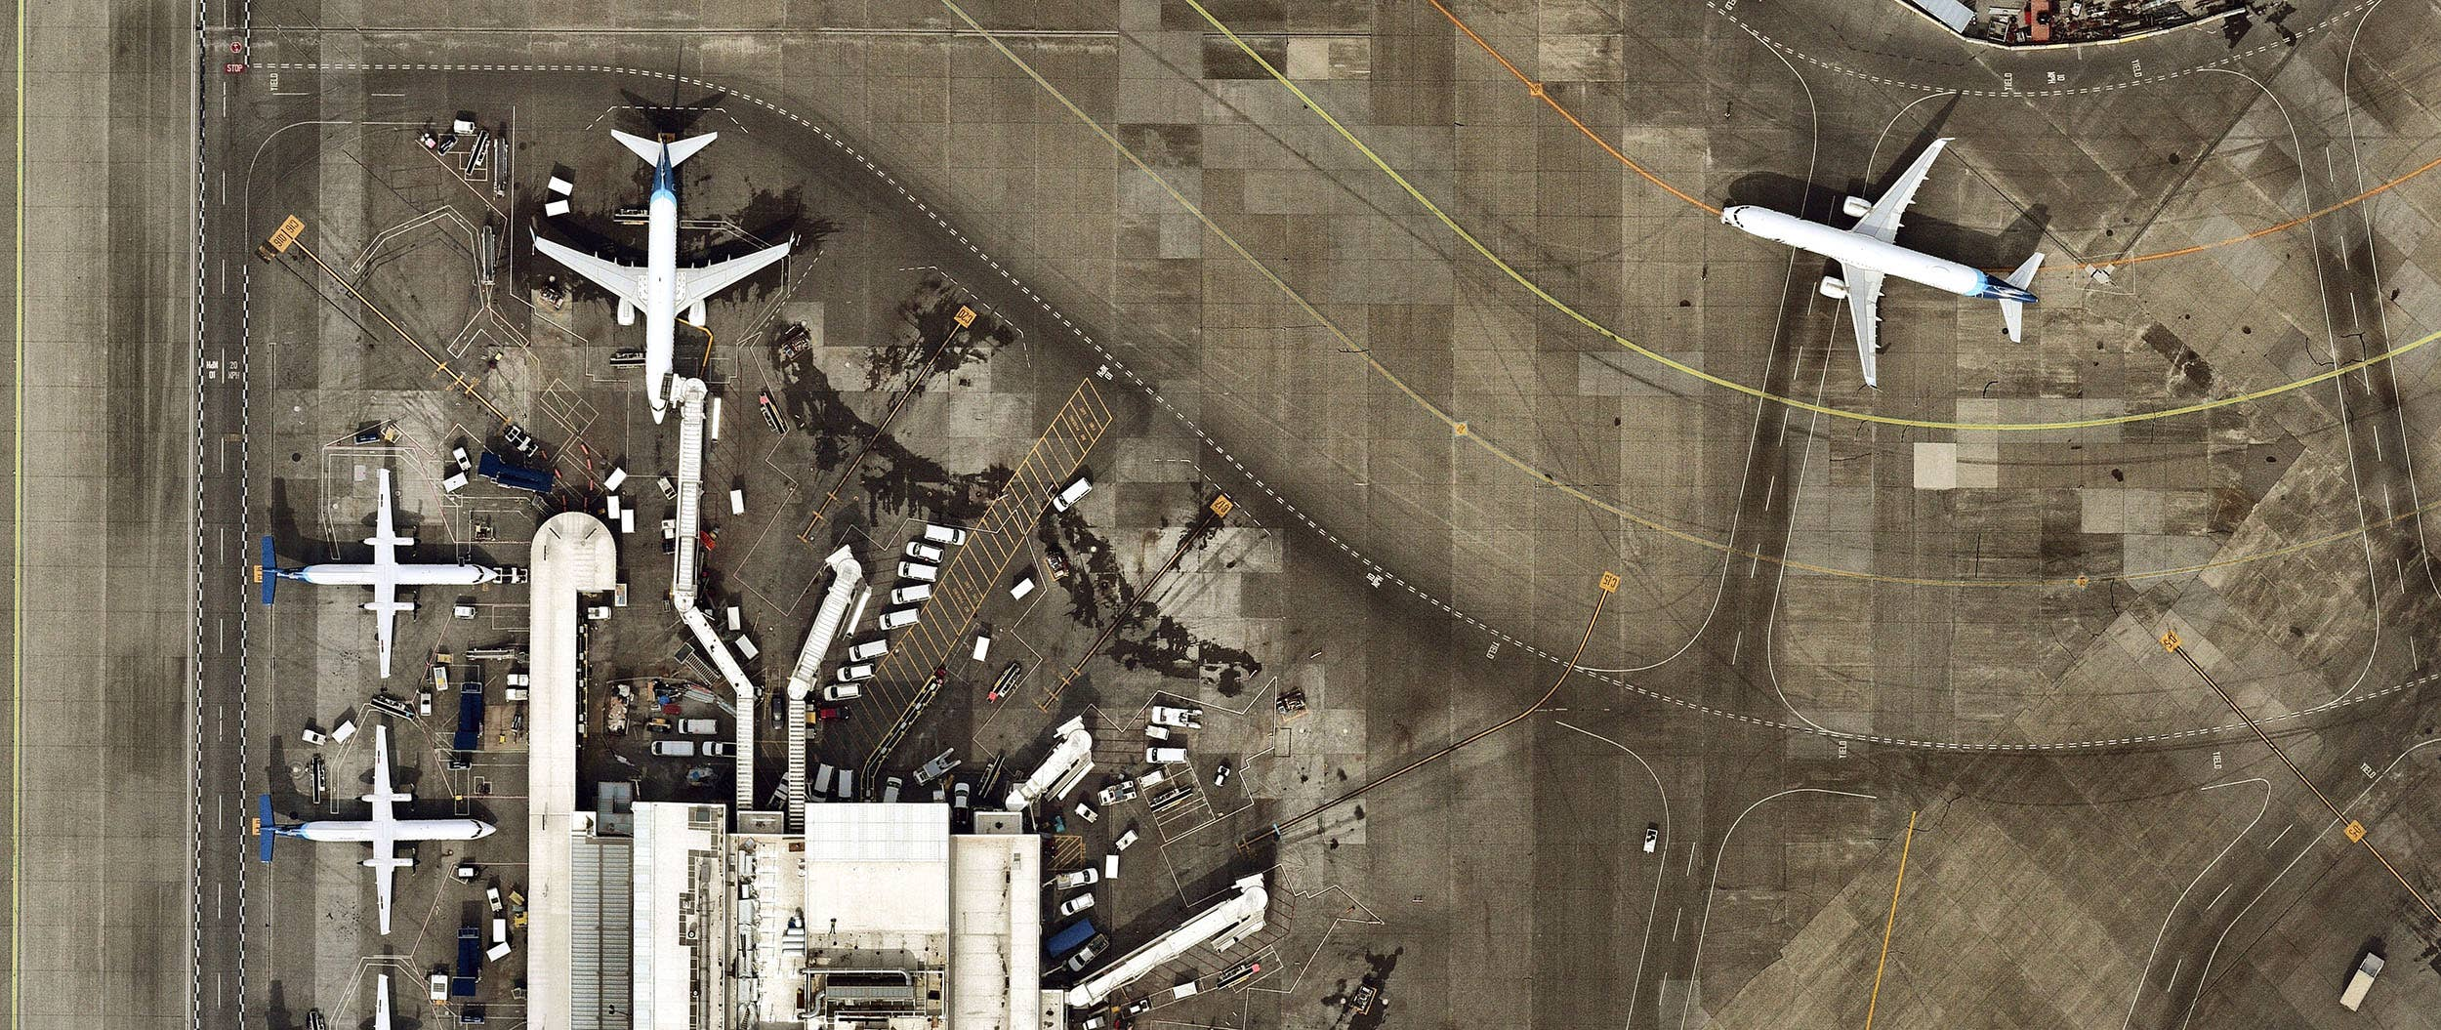
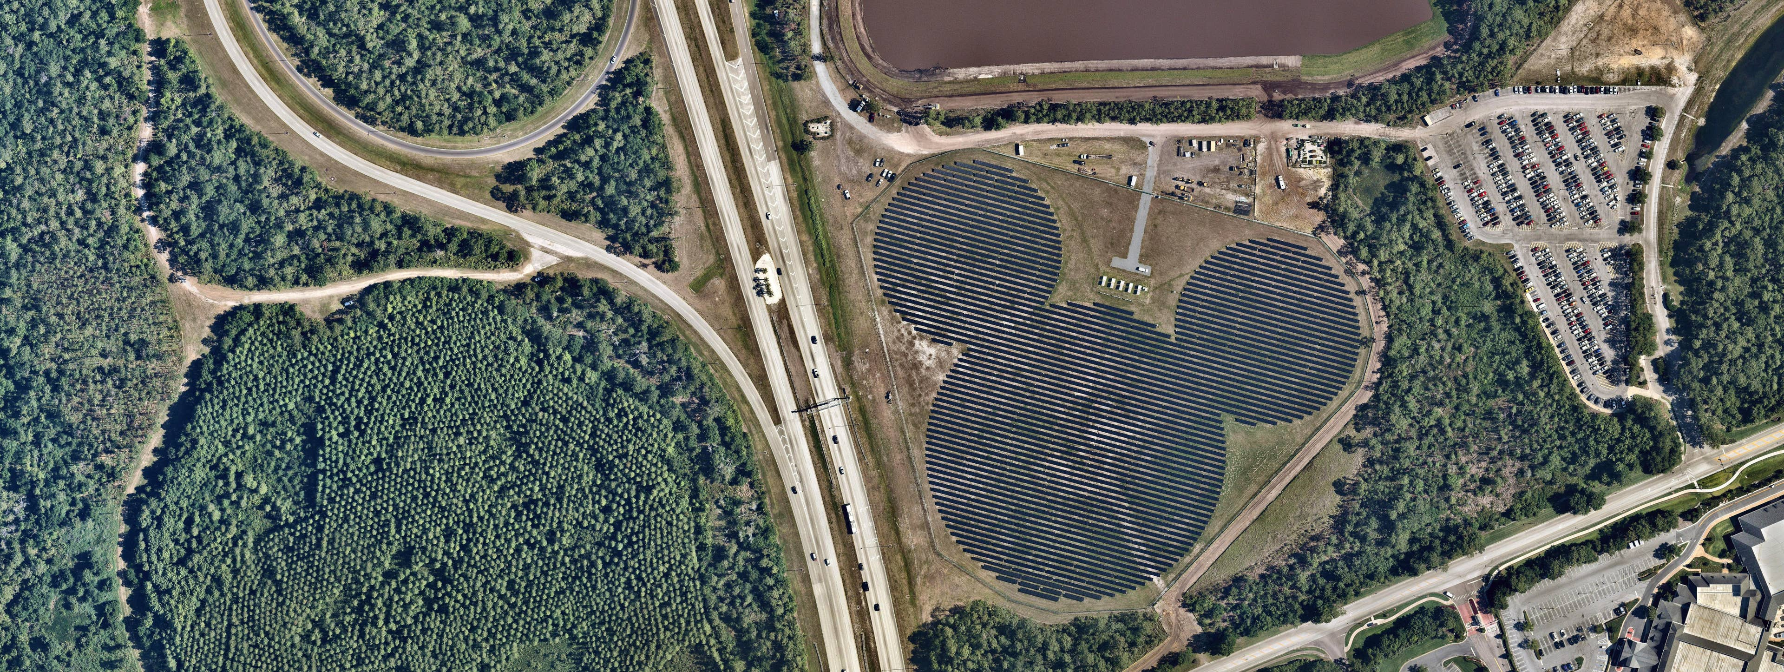
Aerial video images
‘Big and flat’ Plane in the image
Dominated Plane in the Airport
‘Mickey’ Plane in the Field
Introduction
Motivation
Foundation
Approach
Evaluation
Improvement
End
Notes:
First of all, I’d like to introduce the application scenario of my algorithm. My Algorithm is to find compatible [kəm‘pætəbl] homographies between image pairs. Why is it needed? And when should it be used? Let’s find the answer from the following introduction.
From the application, we are in aerial [ˋɛrɪəl] video images. So basically, we are looking at the flat earth surface. Just like these picture shows, there are both big flat planes in the image. In the right image, the ground of airport is a big dominated plane. And in the left, there is micky plane in the field. So These will be regestered in the consecutive[ kənˋsɛkjətɪv] images with global ['ɡləubəl] homography.

Slide 4
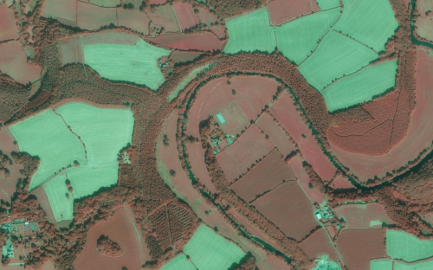

In other cases：not flat enough
Terraces
Mountains
Introduction
Motivation
Foundation
Approach
Evaluation
Improvement
End
Notes:
But for some other cases, if the planes in the image are not flat enough, like the Terraces [‘tereisis] and Mountains in these images. Now the problem comes. The homography only works for the flat parts, but not for the other part anymore. And like in these two images, there are different patches or planes, Only one global homography doesn’t work. In order to track them, more than one homography between an image pair should be used. they can’t be chosen freely, but have to obey some rules. And my algorithm is to find these compatible [kəm'pætəbl] homographies between image pairs.

Slide 5
Registration Technology
SGM
Dense Method
Registration technology
SIFT
Sparse Method
ORB
Introduction
Motivation
Foundation
Approach
Evaluation
Improvement
End
Notes:
The purpose of the thesis is a kind of image registration, some way to find similar structure in both images.
So first introduce the current status of this technology. There are several ways to do this in different situations. They can be divided in dense methods['meθəd]and sparse method.
Dense methods try to match the whole image area, such as SGM. And spares methods only match selected parts, for example SIFT and ORB algorithm. But sometimes, it’s not easy to tell them apart. For example, image stitching with SIFT features uses the sparse Feature points to estimate a dense homography. When I make in the end a dense solution like in the case of the homography in the thesis, but I determine the homography only on some spares feature points, So I still call my algorithm a sparse method.

Slide 6
Sparse Methods
Matching Feature
Harris corners
Scale Space Maxima
Local Binary Patterns
Use descriptor
Tracking
Warp patches
Correct drift to get more accurate results
Extracting Feature
Registration
Introduction
Motivation
Foundation
Approach
Evaluation
Improvement
End
Notes:
Sparse methods mostly start with extracting some “interesting points” or “features”, that are (mostly small) structures in the image, that could be recognized in the other image as well. Typical “interesting points” are Harris corners (used in classical KLT tracker), Scale Space Maximas (used by SURF and SIFT), or Corners from Local Binary Patterns (used in ORB). Because homography is only for flat surface. So now I choose the ROI for a plane by hand. But for futere work, I plan to apply my Algorithm to Harris corners feature.
After extracting the feature, there are two main methods to find them in the other image. The first is to describe the appearance of the image around the feature point in some way ( I call a "descriptor") and search for a similar descriptor in the other image. This is the method of choice, when there is a larger change between the images, like two images taken from several different cameras.
The other way is “tracking”, that means searching them close to the position where they are in the first image -- this only works, when the change between the images is small, like on consecutive frames of a video. This is exactly my situation. So my algorithm use this way.
The big advantage with feature tracking instead of feature matching is, that the actual image patch gets matched and this allows to accurately determine the change of the feature.So after getting the matched two features in image pair, it would be best, to warp one feature patch onto the other and try to register them accurately. Basically, do the same as what we start right now.

Slide 7
Foundation
Multiple Homography
Normal Homography for planes projection
Linked together by latent variables
Main Idea
Epipolar Geometry
Geometry of stereo Images
Implicit constraints
Correlation
Preferred in the field of image matching
In the iterative process
Introduction
Motivation
Foundation
Approach
Evaluation
Improvement
End
Notes:
Before I explain the approach, I’d like to show some foundation of the algorithm. Firstly, is multiple homography. (click)In most cases, there are many different planes in one image. So multiple homograhpy is needed. It is estimating a set of interdependent homography matrices linked together by latent variables from epipolar. For my algorithm, the situation is just the same. It’s used to connect the local [‘ləukəl] homography for each plane.
Then Epipolar geometry(click). It’s often used in the field of stereo matching. It provides implicit[im'plisit] constraints for stereo matching. And My thesis could also be partly proved by the epipolar geometry.
In the end, correlation method(click). Correlation based Method has long been preferred in the field of image matching. And in my thesis, the idea of correlation is also used to optimize the matching result.
--------------------------------------------------
just for your understanding. Actually, what links the different homographies together is the epipolar geometry, so it is somehow strange that you explain it twice, ones in each of the two first points but without mention any relation between them.

Slide 8
Agenda
Introduction
Approach
Evaluation
Future Improvement
Agenda
Notes:
The next part is the main part. Approch

Slide 9
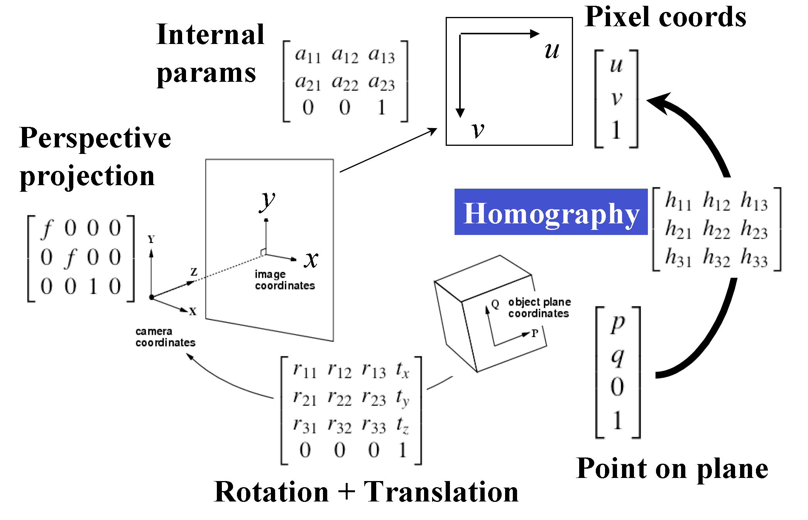
Projection of Points on Planar Surface
Introduction
Motivation
Foundation
Approach
Evaluation
Improvement
End
Notes:
Speaking from the most basic, we all know that if we know the camera position C, camera rotation R and calibration matrix k, we can fully describe the imaging process with these parameters. The transformation could be expressed as a 4 by 3 matrix P when homogenous coordinate is applied. This picture shows this process. Go further, when the object in the image is a plane, the projection process from 3D to 2D is reduced to 2d to 2d transformation. This transformation matrix is a 3 by 3 matrix, called Homography.

Slide 10
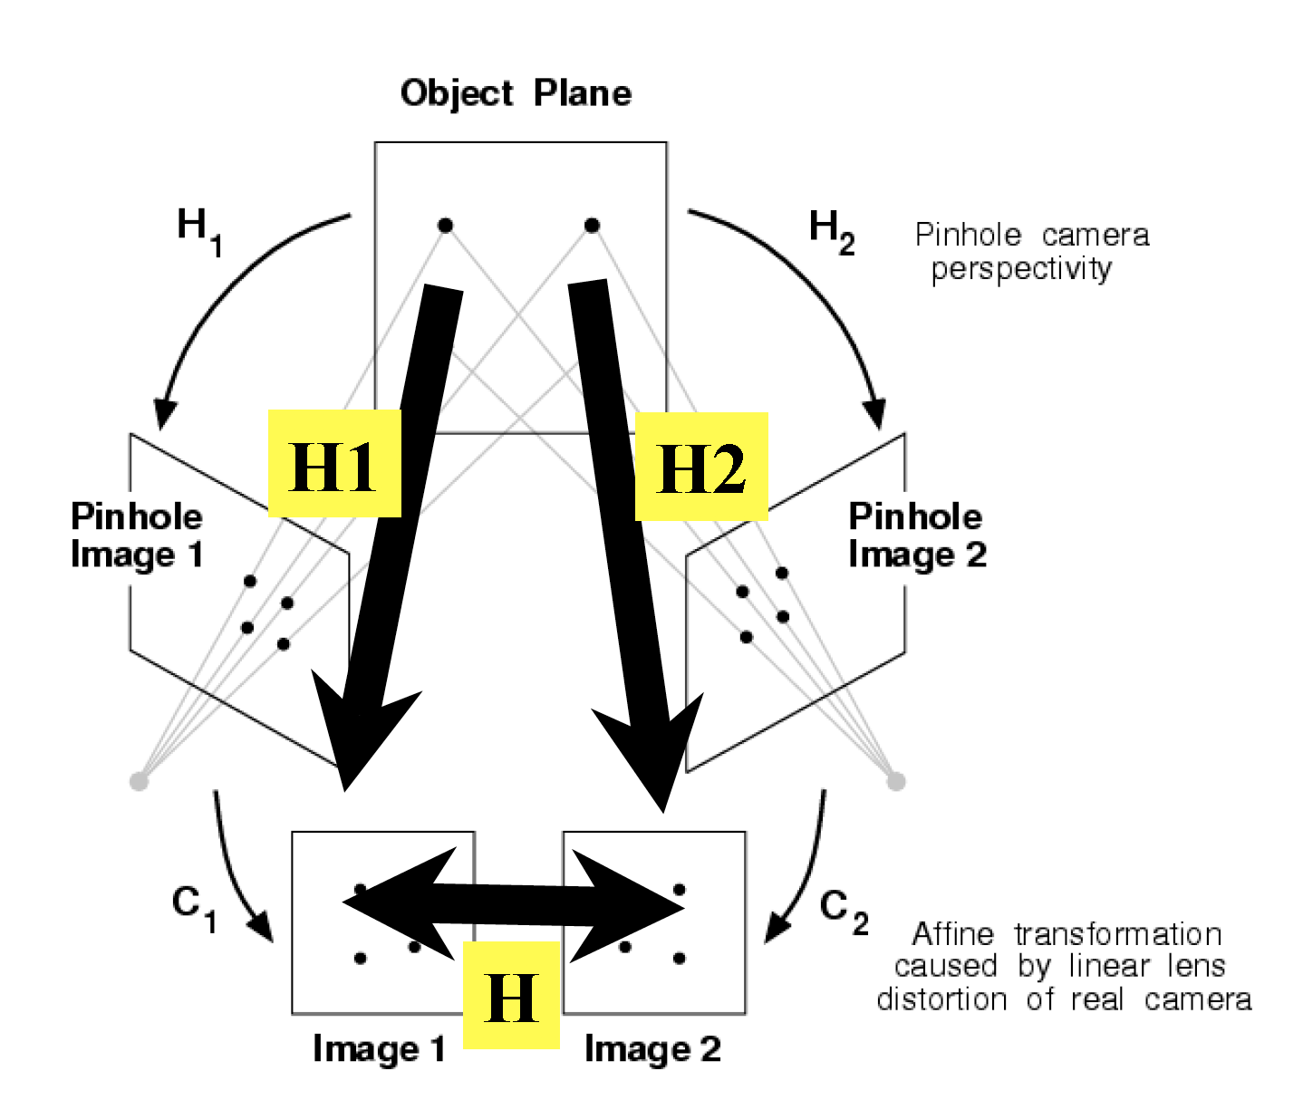
Planar Projection Diagram
Planar Projection Diagram
Introduction
Motivation
Foundation
Approach
Evaluation
Improvement
Summary
Notes:
Followed last slide, After the homography between the object plane and the image is obtained. In the scene that the picture show, there are two cameras for the same plane, the Homography H1 and H2 between the object plane and image could be got. Then H between two image could be calculated by the Homographies H1 and H2. H is equal to inverse h1 times h2.

Slide 11
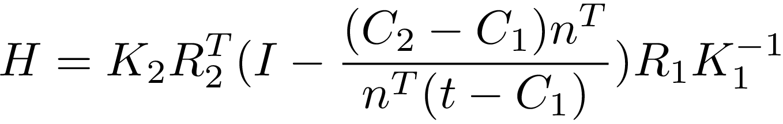
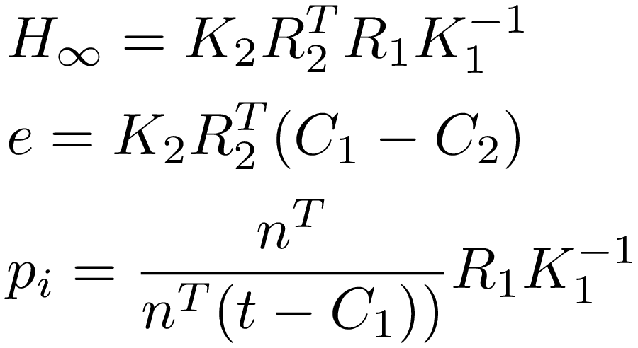
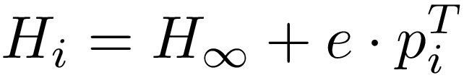
Multiple Homography
Final formula:
C₁, C₂:center of the camera R₁, R₂:rotation matrix K₁, K₂:calibration matrix n: unit normal of plane t: a point on the plane
Rewrite and Rearrange
Introduction
Motivation
Foundation
Approach
Evaluation
Improvement
End
Notes:
So come back to my research area, in the aerial imagery case, with consecutive [kən‘sekjutiv] images of same scene. the homographies between the plane and each image will be got. After some derivation, this formula for the homography of the same plane in two images will be obtained. With these definitions,
I have rewritten and rearranged it in the form below H_i equals to H_infinty plus e times p_i Transpose.
Here H_i means the homography for plane i between image pair. And H_infinity means the homography for infinity plane, e means the epipolar line in the image. And it just fits the form of multiple Homography. P_i is a local variable, and H_inf and e are global variable. H_i per plane is connected by latent variable H_inf and e.
For aerial [‘εəriəl] images, we have an estimation of all the parameter shown the here. So I do have already an estimate of H_infinity and e. Moreover I know approximately where the ground plane is in the images, this gives us also an estimate of p_i.
-----------------------------------
And some simple feature points like Harris corners can be easily extracted here. And p_i has an odd form, it makes sense to group several local features together to a large ROI in one plane.
feature points can be grouped together to get a more robust solution or something
Among them C1, C2 are the center of the camera. R1, R2 are rotation matrix. K1, K2 is the calibration matrix. n is the unit normal of plane. t is a point on the plane.
If the images are rectified stereo images. The rotation matrix would be identity matrix. The baseline is 1. And the calibration matrix is a 3 by 3 matrix with the diagonal f f and1.
After simplified, the Homography matrix becomes this form. There are only parameters in the first row. That means only the x coordinates changes for corresponding points in stereo images.
And it could also be explained by epoplar geometry. Because these are rectified stereo images. There is an epipolar constraint. The corresponding points must lie on the epipolar line, and the epipolar lines in both images are on the same level in the rectified case. That’s why there are only parameters in the first row of the matrix.

Slide 12
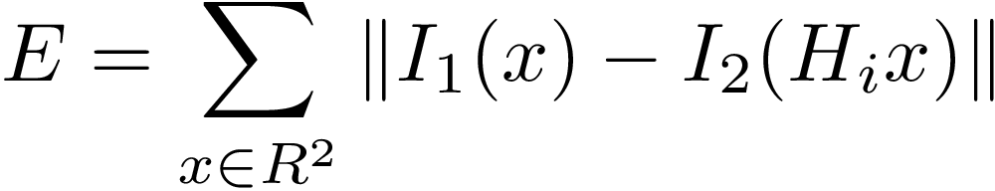
Outline
Minimize Warping Error:
More accurate H_{i} （i.e. more accurate $H_{∞}$ e and p_{i}）
Calibration the camera (i.e. Refine the parameter C, R and K)
Introduction
Motivation
Foundation
Approach
Evaluation
Improvement
End
Notes:
After the initialization, H_{i} could be used to warp the the region of interest (plane here)in template image to the target image, And here I1 and I2 means the gray value of each pixel in template image and target image. x means the coordinate per pixel in the ROI of template image.
Because the information from the camera is not 100 percent accurate. There might be some drift between template image and warped image. My idea is to minimize the warping error E(x) to register the parameter more accurate. And the finall result could be used to calibrate the camera further. So it has a very important meaning.

Slide 13
Approach
Rectified stereo images
Unrectified stereo images
Simplel case
Fewer variables
Simple formula
Explained by Epipolar Geometry
Be proved fast and accurate
General case
More variables
Complex formula
Explained by Multiple Homography
Optimal solution for overdetermined equations
Introduction
Motivation
Foundation
Approach
Evaluation
Improvement
End
Notes:
After the outline, let’s see more details in the algorithm.
Generally, the thesis is able to be divided into two steps. First is the simpler situation ‘rectified stereo image’ and the other is the more complicated situation ‘unrectified stereo images, or normal image pair’.
For the rectified stereo images, it’s a simple case, that means with fewer variables and simple formula. It leads to the unrectified stereo images.
And the unrectified stereo image is the case which interests us so much. This is the general case with more variables and complex formula. And the multiple homography I mentioned before is also used here.
-------------------------------------------------------------------------
In my mind this page is needed. Because this tells people how the thesis is structure of the thesis. And make it clear.

Slide 14
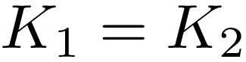
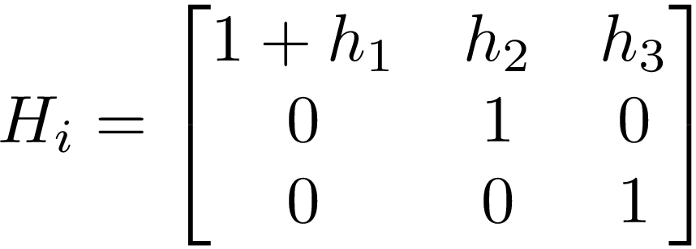
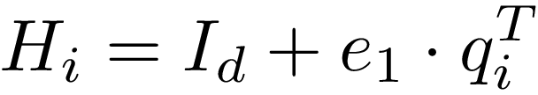
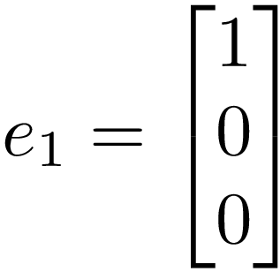
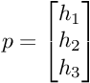
Rectified Stereo Image
Homography matrix :
Among them:
T
T
simplified
for Rectified Image
With:
For plane I in the image:
Introduction
Motivation
Foundation
Approach
Evaluation
Improvement
End
Notes:
Start with this homography matrix Hi , the simplest case is where the image is rectified stereo image.
In this case the rotation matrix would be identity matrix. The baseline is 1. And the calibration matrix is an upper triangular 3 by 3 matrix.
After simplified, the Homography matrix becomes Id plus e times p_i. Id is a 3 by 3 identity matrix. There are only parameters in the vector p_i. Written in matrix form.(click mouse)
In this case, it’s obviously, only the x coordinates changes for corresponding points in stereo images. It also complies with the constraint of epipolar geometry.
So the problem changes from H_i estimation to p_i estimation.
----------------------------------------------------------------------------------
And this form could also be explained by epoplar geometry. Because these are rectified stereo images. There is an epipolar constraint. The corresponding points must lie on the epipolar line, and the epipolar lines in both images are on the same level in the rectified case. That’s why there are only parameters in the first row of the matrix.

Slide 15
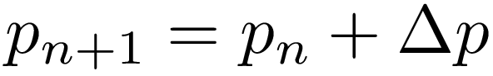
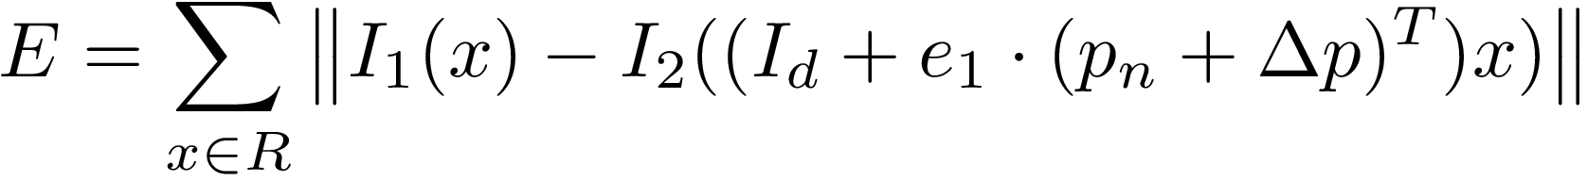



The iterative process (Rectified stereo images)
Reach stopping criterion
Result
Initialization
Start iteration
$$p_{0}$$
$$p_{n}$$
$$p$$
Minimization
2
Notes:
Now I apply the iterative process mentioned before to estimate p_i for plane i.
This diagram shows the iterative process. First the initialization of p should be set. And delta p is the optimized value for each cycle of vector p. And my aim is to minimize the warping error E with suitable delta p. For each pixel in the roi, this equation can be built, the same as E approximately equal to 0. Solve this equation system to get delta p. Then p would be updated [ʌp'deitid]. The iterative process stops when the stopping criterion [kraɪˈtɪərɪən] is reached. In other word, the warping error is small enough.

Slide 16
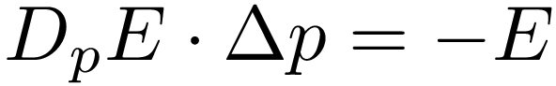
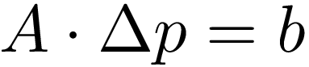
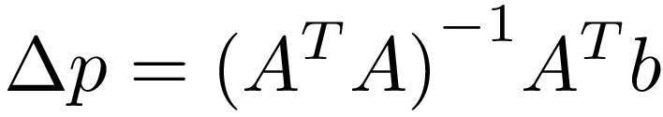
Minimization
2
Minimize Warping Error:
Linearization
Organized into simple form：
It is an overdetermined linear equation system. Finally, Solve the equation system:
Introduction
Motivation
Foundation
Approach
Evaluation
Improvement
End
Notes:
Minimize the warping error for all pixels in the ROI. I have E approximately equals to 0. After linearization, this equation system could be built. It could be organized into simple form, A times delta p=b. Solve this overdetermined equation system to get delta p. The result is below. It a typical Gauss-Newton-step.
What’s more, In some cases, it will converge at a local minima, not the global minima. But a good Initialization could greatly reduce the occurrence of this situation.
Let’s see some results of this case

Slide 17
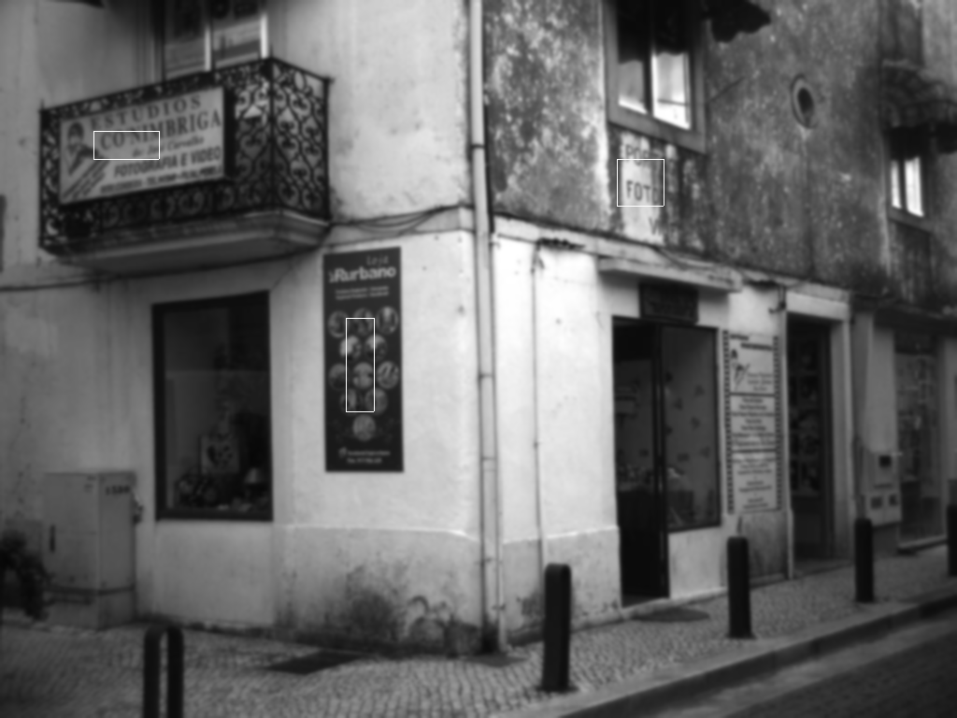
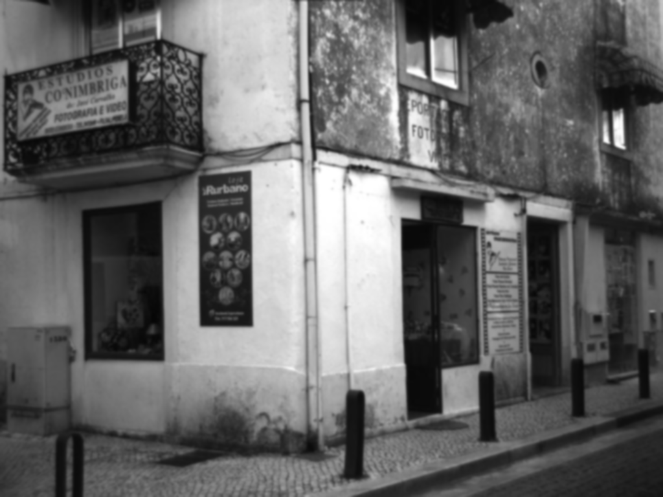
Result of Rectified stereo images
Original Target Image(Left)
Original Template Image(Right)
Introduction
Motivation
Foundation
Approach
Evaluation
Improvement
End
Notes:
This is the whole image, which I will apply my algorithm on. And I choose three planes to do the warping. First one is the billboard on the balcony. The second is the poster on the left wall. And the last is the words on the right wall. But they are not perfectly stereo rectified. So there are still some offset in the result.
Next let’s see the results one by one.

Slide 18

Result of Rectified stereo images
Template Image of ROI 1
Introduction
Motivation
Foundation
Approach
Evaluation
Improvement
End
Notes:
This is The billboard on the balcony. This the template image of ROI 1.

Slide 19

Result of Rectified stereo images
Warped Image of ROI 1
Introduction
Motivation
Foundation
Approach
Evaluation
Improvement
End
Notes:
And the warped image. And there is still some drift here. The reason may, that it stuck only in the local minima. And I will find the reason and fix it in the next work. or the illumination is not the same. And until now, I didn’t do radiometric correction.

Slide 20

Result of Rectified stereo images
Template Image of ROI 2
Introduction
Motivation
Foundation
Approach
Evaluation
Improvement
End
Notes:
The post on the left wall, Template image

Slide 21

Result of Rectified stereo images
Warped Image of ROI 2
Introduction
Motivation
Foundation
Approach
Evaluation
Improvement
End
Notes:
and warped image. It’s much better. Almost the same.

Slide 22

Result of Rectified stereo images
Template Image of ROI 3
Introduction
Motivation
Foundation
Approach
Evaluation
Improvement
End
Notes:
The word on the right wall

Slide 23
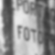
Result of Rectified stereo images
Warped Image of ROI 3
Introduction
Motivation
Foundation
Approach
Evaluation
Improvement
End
Notes:
And the warped image. Unfortunately there is still offset. I will check if there is a bug in the algorithm or it really stuck in a local minima in the following work.

Slide 24
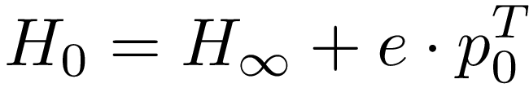
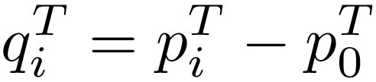
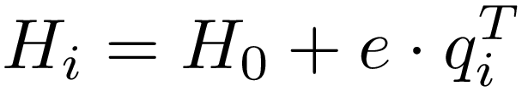
Homography for unrectified Image
Homography matrix :
Homography matrix of plane i for unrectified Image:
Introduction
Motivation
Foundation
Approach
Evaluation
Improvement
End
Notes:
Now let’s look on the second parts of the approach, estimating homography for unrectified image. Just like what we have done for rectified images, it starts also with this Homography, but this time, there is not special matrix in the formula.
In most images, maybe we can’t find a plane at the infinity. But we can get a homography matrix h0 for one plane exists, and then still 𝐻𝑖=𝐻0+𝑒q𝑖𝑇 holds for q𝑖=p𝑖−p0
What we have to notice is that H 0 is a 3 by3 matrix, and e is a vector of 3 elements. They are for the whole image. we can see them as global variables. And also, the q_i is a vector of 3 elements. And it’s different for different planes in the image, so we can see it as a local variable for plane i.
This time I should not only optimize q_i but also H_o and e. But the main idea doesn’t change. It’s still to minimize the warping error E
Method used for uncalibrated image(Mutiple Homography, Iterative estimation, last square correction, )

Slide 25
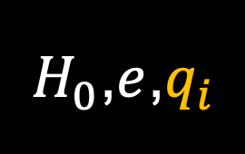
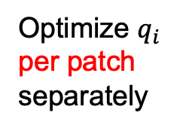

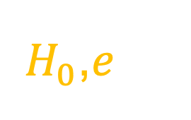

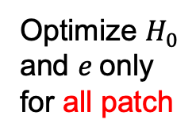
The iterative process (unrectified image)
Optimize $q_{i}$ per patch separately
Initialization
Reach stopping criteria
Result
Start iteration
$H_{0}$,$e$,$q_{i}$
$H_{0}$,$e$,$q_{i}$
$H_{0}$,$e$,$q_{i}$
$H_{0}$,$e$,$q_{i}$
Optimize $H_{0}$ and $e$only for all patch
Notes:
For unrectified images, the iterative process is composed of two parts. Optimize pi and optimize H0 and e
After the initialization, we can warp the image. Then first hold the ho and e, optimize qi for every patch separately. Then holds every qi, optimize Ho and e for all patches. The two parts
alternately [ɔ:l‘tə:nitli] cycle until the stopping criteria[kraɪˈtɪərɪə] for all the parameter are reached.

Slide 26
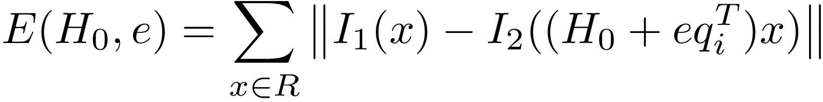
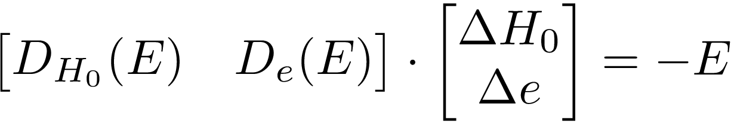
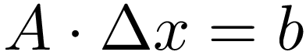
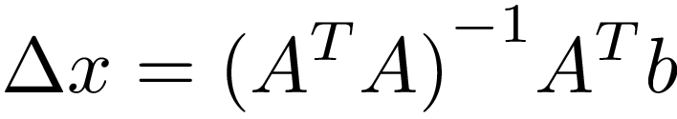

Optimize $H_{0}$ and $e$
2
Minimize Warping Error:
Linearization
It‘s of the form:
Solve:
Introduction
Motivation
Foundation
Approach
Evaluation
Improvement
End
Notes:
For this iterative process, q_i is optimized using the same method for rectified image. For H0 and e, I used the same idea, minimize the warping error E. After linearization, this equation system can be built. It’s of the form A times delta x equals to b. Here, Delta x means this vector delta h0 an delta e. The result is soveled blow.
Btw, in the process, I have skipped some steps. For example, there are some homogenization and dehomogenization steps. Furthermore, in the calculation, I have changed all the matrix into vector, in other words, vectorization.

Slide 27
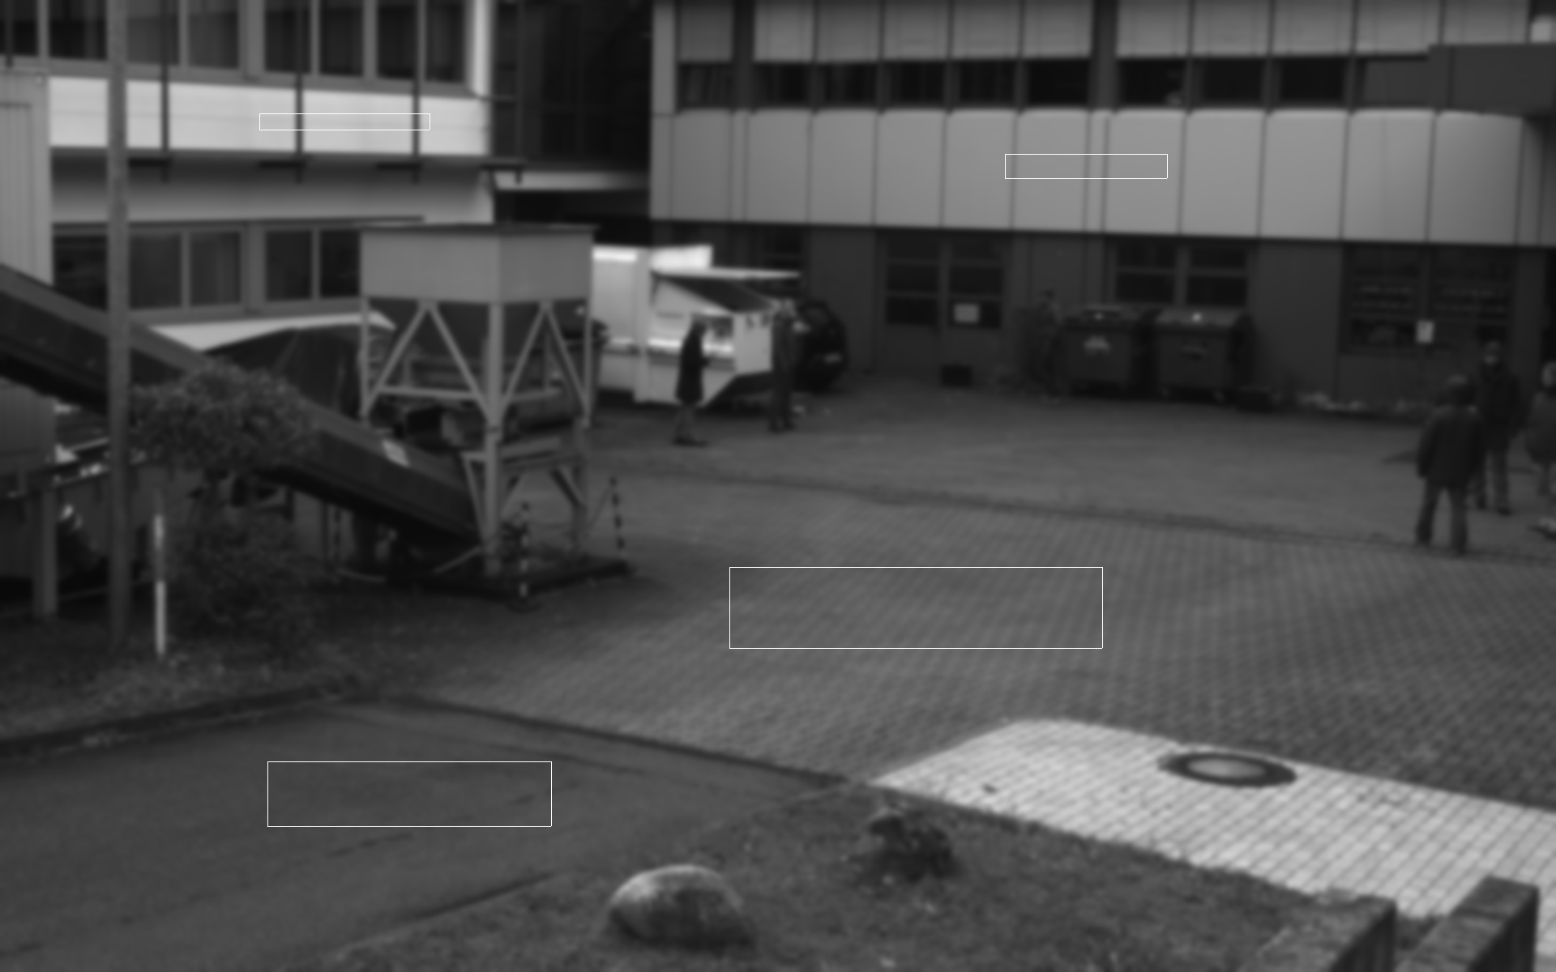
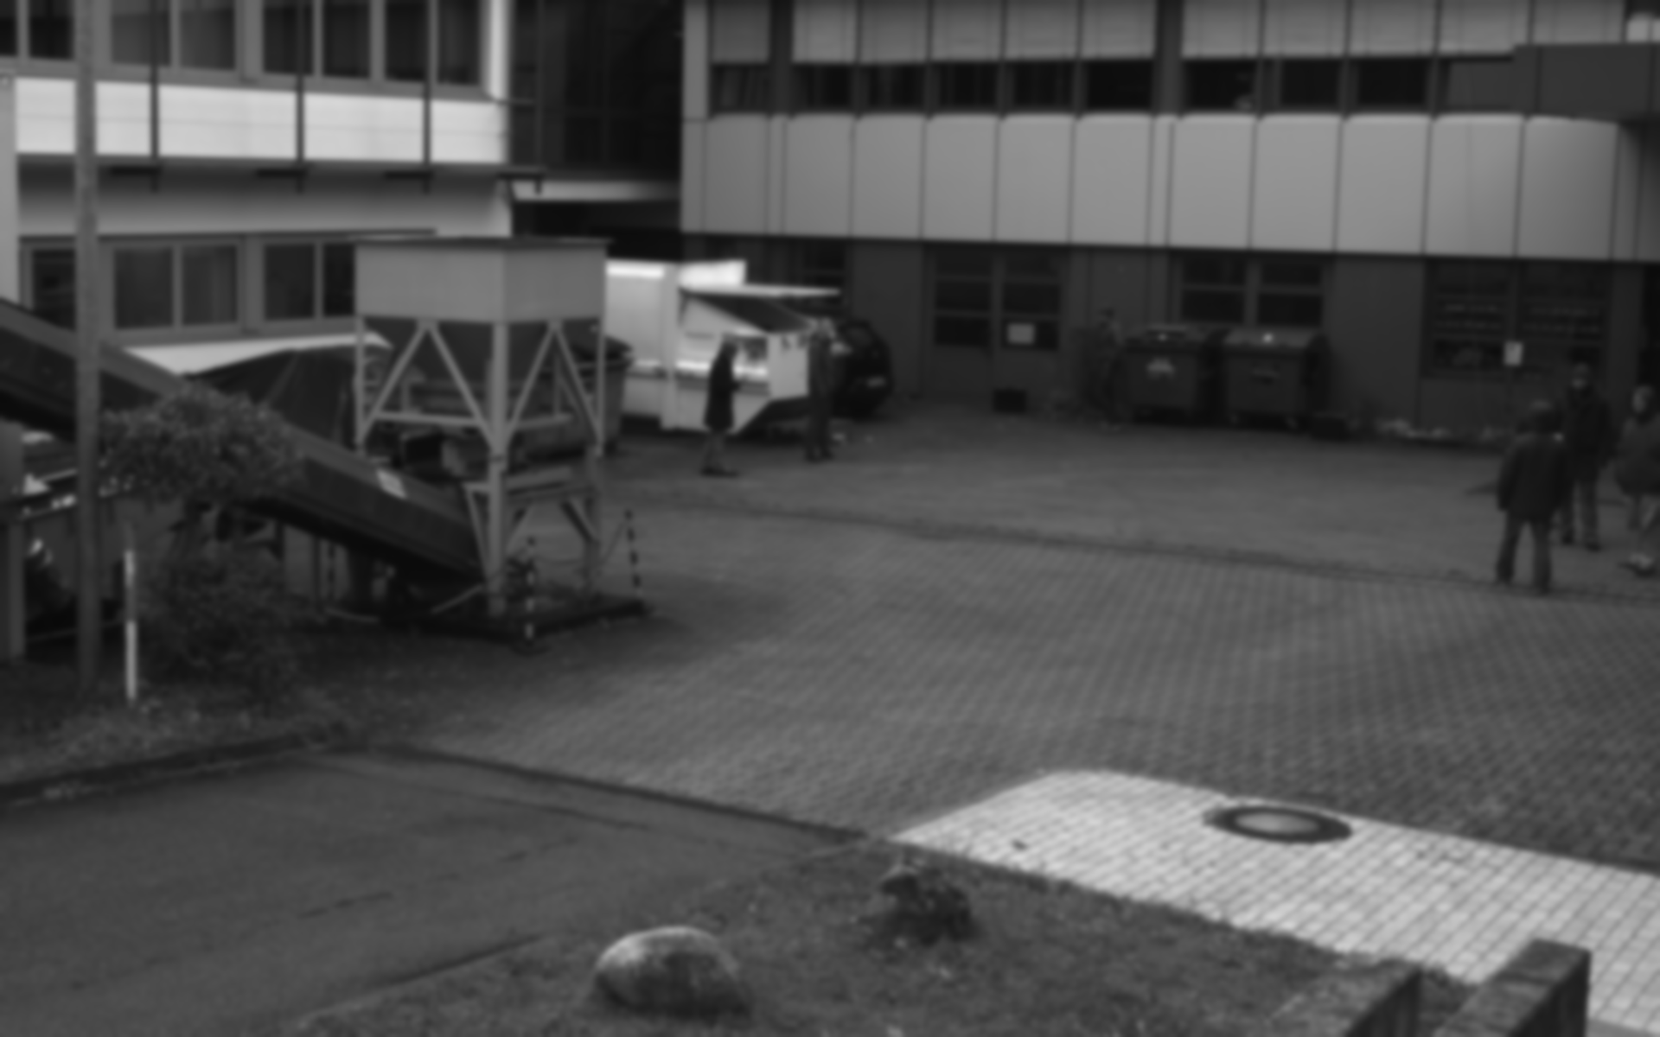
Result of unrectified image
Original Target Image(Left)
Original Template Image(Right)
Introduction
Motivation
Foundation
Approach
Evaluation
Improvement
End
Notes:
Now I will show some result of the unrectified images. First, we will see the whole image. I choose 4 ROI in the image, where the algorithm is applied. There are four white squares in the Target image, I will warp this four area in the template image with different homography matrix.

Slide 28


Result of unrectified image
Template Image of ROI 1
Template Image of ROI 2
Introduction
Motivation
Foundation
Approach
Evaluation
Improvement
End
Notes:
the template image of ROI1 and 2
the warped image of ROI 1 and 2

Slide 29


Result of unrectified image
Warped Image of ROI 1
Warped Image of ROI 2
Introduction
Motivation
Foundation
Approach
Evaluation
Improvement
End
Notes:
the warped image of ROI 1 and 2
---------------------------
ROI 2 is actually not well chosen for the algorithm since it has some high frequent periodic structure in it. One would usually either reduce the image size to not have that much periodicity or blur the image to reduce the high structure. Otherwise, if the initial value is not very accurate, the algorithm might stuck with an offset of one or a couple of periods. You don’t have to change this, but you should be prepared to explain this if people ask questions.
----------------------
On slide 29, Roi 1 and 2 have mostly a vertical offset in the same direction. Since Roi 3 and 4 don't restrict the vertical translation of H_0 (because of the vertical translation symmetry), it should be easy for the algorithm to correct this offset in the images, but since it doesn't do that, I suspect there also something wrong (probably the same error as in the p-step, maybe something with the gradients, therefore it is a good idea to visualize the intermediate results after you presentation). There is a periodic patern in Roi 2, but since the offset between the the template and warped image is just about a quarter of the period, this should not be a problem in this case.
Roi 1 hase some slight changes in illumination. We have talked about this before, that actually the algorithm also needs a radiometric correction as suggested in the paper from AW Gruen and here, this could have an effect, so we should add this. (It will be quite simple, in the minimizing function E you simply replace I_1(x) by a*I_1(x)+b and in the linearization, also take the derivative with respect to a and b. D_a E = I_1, simply, and D_b E is even more simple, just the constant vector with only 1es. So, you add this two columns to your matrix A and optimize for (Delta p, Delta a, Delta b) instead of just Delta p, and for (Delta H_0, Delta e, Delta a, Delta b) in the H,e-step.)

Slide 30


Result of unrectified image
Template Image of ROI 3
Template Image of ROI 4
Introduction
Motivation
Foundation
Approach
Evaluation
Improvement
End
Notes:
the template image of ROI 3 and 4
the warped image of ROI 3 and 4

Slide 31


Result of unrectified image
Warped Image of ROI 3
Warped Image of ROI 4
Introduction
Motivation
Foundation
Approach
Evaluation
Improvement
End
Notes:
There is still an offset for ROI 4. Because the thesis is not fully finished. I will continue to optimize it in the next work.
----------------
On slide 30, Roi 3 is almost perfect, but the patch has a (almost) vertical symmetry, therefore, it does not restrict the Homography (H_0, as well as p_i) vertically. Roi 4 is actually from the perspective of the algorithm also quite good registered. The horizontal black line does not overlap in the two images, so the algorithm can't see in which direction it goes better, so it will totally ignore it, and the vertical bars are quite good registered. However, again, the small horizontal shift in the left vertical bar should be possible to improve with p_i, and since this does not happen, I suspect an error in the p-part of the algorithm.

Slide 32
Agenda
Introduction
Approach
Evaluation
Future Improvement
Agenda
Notes:
In the end I will first talk about the evaluation and then the improvements.

Slide 33
Evaluation
Dataset with ground truth:
1. Public datasets
2. Self-built datasets
Test with the dataset with ground truth
Compare with other algorithm
Introduction
Motivation
Foundation
Approach
Evaluation
Improvement
End
Notes:
For evaluation, there are 3 steps. Above all, the dataset with ground truth must be got. Next test the algorithm with the dataset. Finally compare with another algorithm.
There are two ways to get the dataset. One is using the public datasets, the other is using self-built datasets.
-------------------------
Homography Estimation using Affine Correspondences
Homography estimation in OpenCV

Slide 34
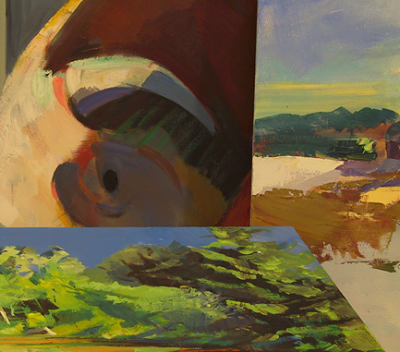
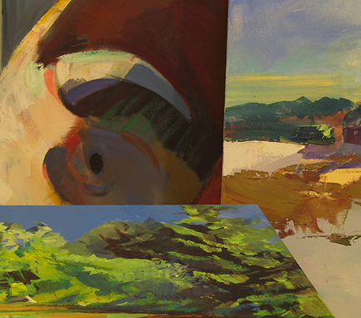
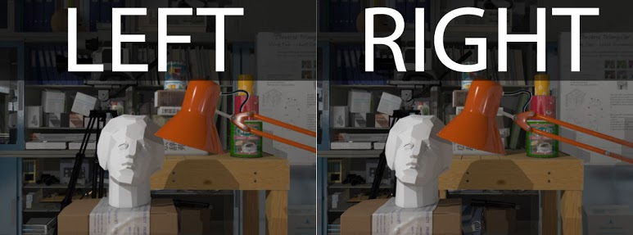
Public Datasets
Middlebury Stereo Vision Datasets
New Tsukuba Stereo Dataset
LEFT
RIGHT
Unsuitable:
Only Rectified stereo image
Unsuitable:
Not enough big plane
Introduction
Motivation
Foundation
Approach
Evaluation
Improvement
End
Notes:
There are many different public datasets for image matching available on the Internet.
For example, there are two frequently used datasets for matching problem. Middlebury stereo vision datasets and new Tsukuba stereo dataset. They are both partly suitable for my algorithm. For Middlebury dataset, there are only rectified images. It can only be used for rectified situation. I can’t use it for estimating H0 and e. And for the New Tsukuba dataset, there is not enough big plane in the image. So it’s not very suitable.

Slide 35
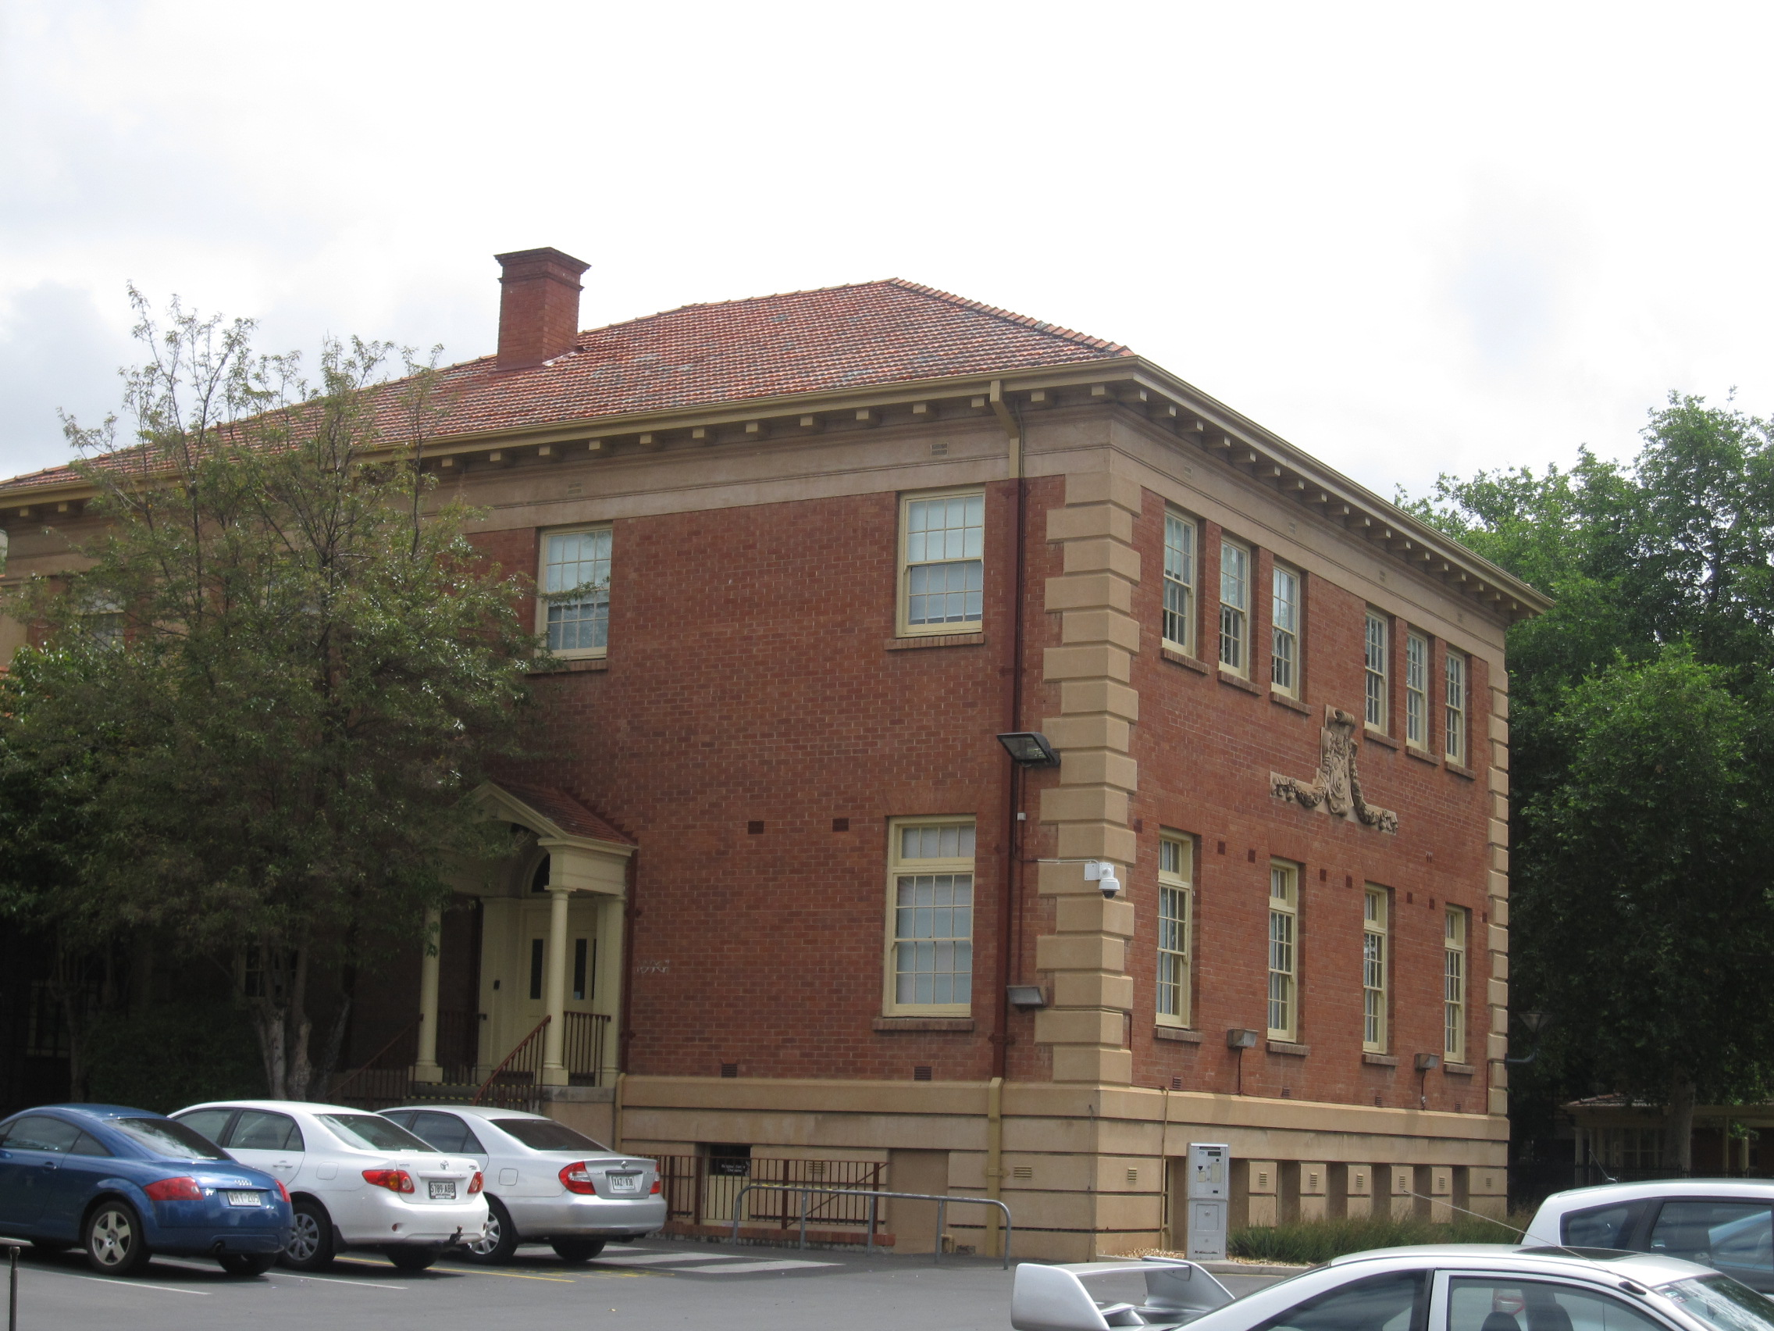
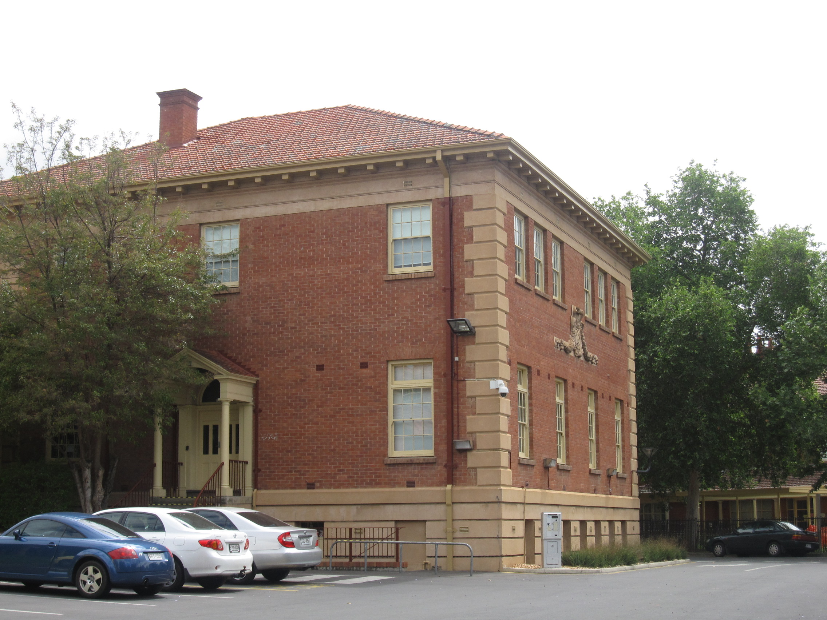
AdelaideRMF
LEFT
RIGHT
Introduction
Motivation
Foundation
Approach
Evaluation
Improvement
End
Notes:
But some image pair from The dataset Adelaide [‘ædəleid] RMF suits my algorithm well. Like the image pair on the slide, there are several planes in the image and are unrectified. What’s more, it uses SIFT feature to estimate the homographies between images. The result is in the dataset. But it isn’t the real ground truth, either. So in the next work, probably I have to build my own dataset with ground truth.
---------------
AdelaideRMF is a data set for robust geometric model fitting ( homography estimation and fundamental matrix estimation).

Slide 36
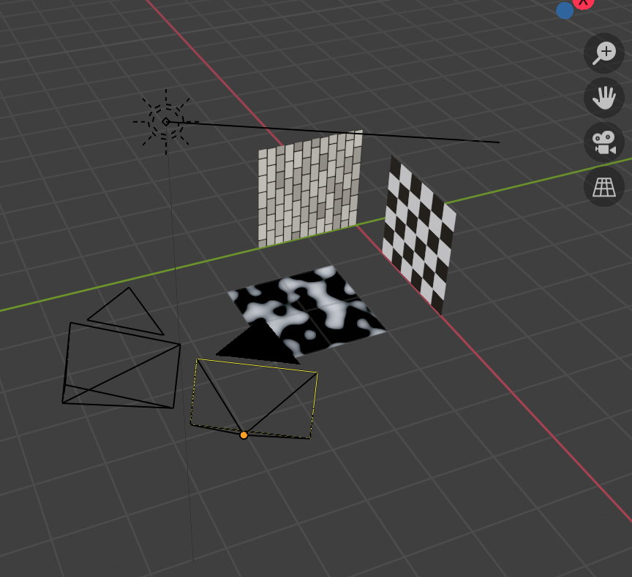
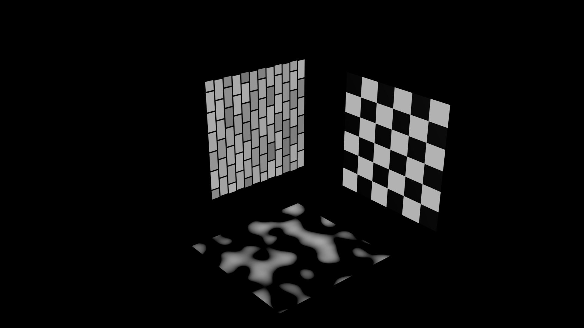
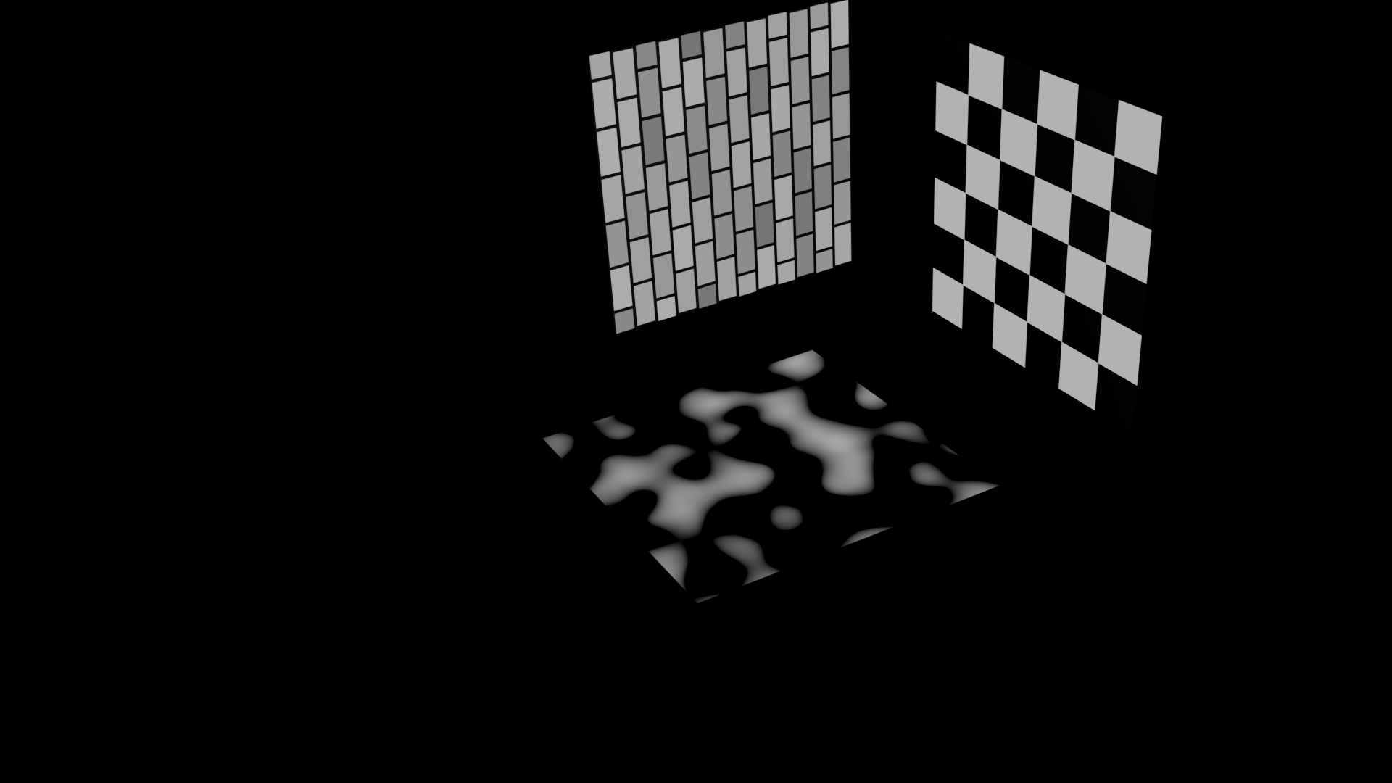
Self-built Datasets
Image from left camera
Image from right camera
Test Scene in blender
Introduction
Motivation
Foundation
Approach
Evaluation
Improvement
End
Notes:
The second way is to build my own test dataset. This picture shows a test scene which I have built in the application blender. It has two cameras with the same intrinsic parameters and different extrinsic parameters. And there are three object planes in the virtual world. From these two cameras, I can get two unrectified images.
Because we know all the parameters for the scene. I can calculate the exact homography matrix for every plane. And of course, I can generate arbitrary planes in blender, not only the planes orthogonal to each other.
These are the images from this scene.

Slide 37
Agenda
Introduction
Approach
Evaluation
Future Improvement
Agenda
Notes:
Final part future improvement

Slide 38
Feature improvement
I. Verify the correctness of the program
II. Preprocess public datasets and
generate own images for evaluation
III. Evaluate the Algorithm
IV. Write Thesis
Introduction
Motivation
Foundation
Approach
Evaluation
Improvement
End
Notes:
From the offset of the warping image. I know, there are still lot of work to do. I’d like to work in followed 4 steps.
First, I will finish the process of checking and verification of the program, probably also need to debug. And if needed ,add the radiaometrix correction to the algorithm to improve the result.
Then, I plan to preprocess the public datasets and generate my own testing scene and images
With them, I’d like to evaluate the algorithm
Finally, write the thesis.

Slide 39
THANK YOU FOR YOUR ATTENTION !
QUESTIONS & COMMENTS ?
Introduction
Motivation
Foundation
Approach
Evaluation
Improvement
End
Notes:
My algorithm is to estimate the homography between image pairs. It has great sense for camera calibration, 3D reconstruction and so on. It’s a meaningful, creative and challenging project. Meanwhile I meet much difficulty in the work. Luckily, I have my great supervisors,(ser) Mr. Erdnusse and Prof. Dr. Mikut. So I want to say thanks to them, right now.
Thank you for your attention! Do you have any questions or comments?

Slide 40
Radiometric Correction
Sensor Calibration
Sensitivity of Detectors
Sun Angle/ Surface Slope
Atmospheric Correction
Vignetting Effecting
Sun Angle Effect
Topographic Effect
Absorption
Scattering

